Slide 1
IMAGE Caption generation using CNN and lstm
Team 21
Omkar Reddy Gojala
Mrinalini Injeti Ramakanth

Slide 2
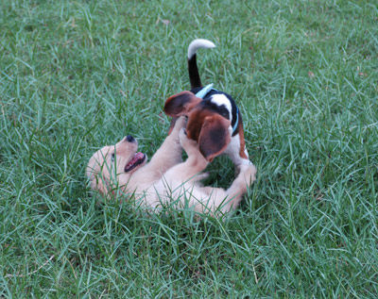
Description
Goal is to generate a descriptive sentence of an image
Project was inspired by the works of Andrej Karpathy and Marc Tanti et al.(2017)
Potential Applications:
Aiding visually impaired
Generating video summary using individual frames
Neural
Network
Two dogs are wrestling in the grass

Slide 3
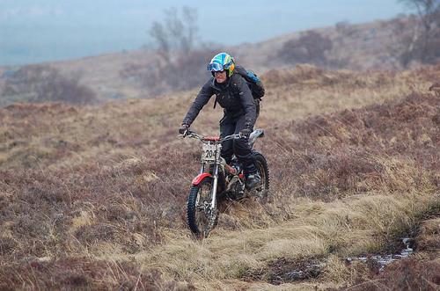
DataSet
We used Flickr8K dataset for this project
Flickr8K dataset contains a variety of images depicting scenes and situations
The dataset consists of 8000 images and each image has 5 corresponding descriptions
We split the data into 6000, 1000, & 1000 images as training, validation and testing sets respectively
The images are of different dimensions
A man riding his bike on a hill
A man with helmet and backpack standing on dirt bike in a hilly grassy area
A person rides a motorbike through a grassy field
Man on motorcycle riding in dry field wearing a helmet and backpack
The biker is riding through a grassy plain .

Slide 4
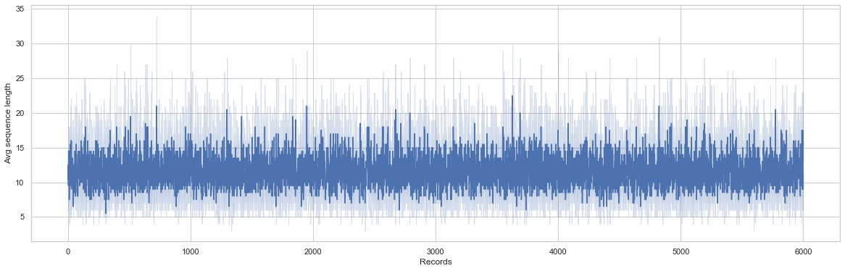
Text Pre-Processing
Each description is tokenized and converted to lowercase
Removed alpha-numeric characters and punctuation marks
We use startseq and endseq as prefix and postfix for each caption respectively
Filtered out unique words from the corpus and represented each word by an integer
To generate a fixed length word vector we calculated the maximum length caption

Slide 5
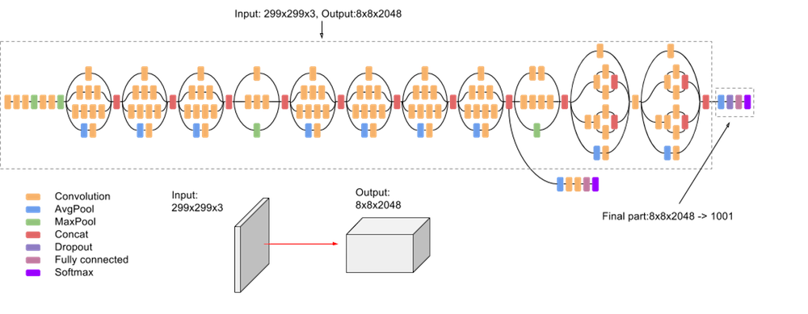
Image feature generation
Resized all images to a fixed size of 299x299x3 using OpenCV
Employed transfer learning using pre-trained InceptionV3 CNN model to encode images
We removed the last softmax layer from the InceptionV3 network to extract 2048 image vector

Slide 6
Sequential Caption Injection
For each image we will train the model by temporally injecting incremental sequences of the description
In this phase, we essentially create labels in our training data
Image | Partial Caption | Target Word
Image | startseq | a
Image | startseq a | young
Image | startseq a young | boy
…… | …… | ……
Image | startseq a young boy wearing a helmet and riding a bike in a park | endseq

Slide 7
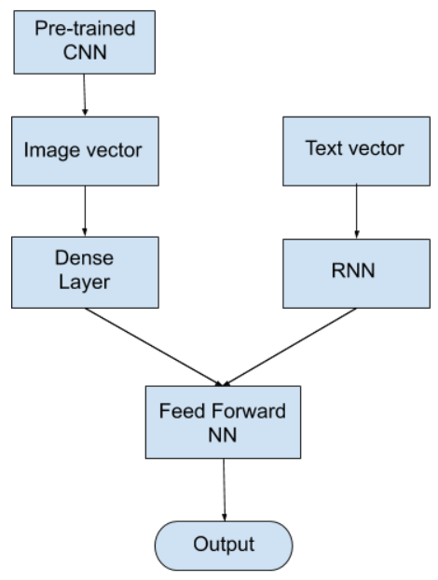
Architecture
We used an encoder-decoder architecture
2048 image vector is fed to a Dense layer to generate 256 length image vector
34 length word vector is fed to LSTM/RNN to output 256 length word vector
Decoder model adds both the encoder outputs and is fed to Dense 256 layer
The last Dense layer will have as many nodes as the vocabulary size
The last softmax layer predicts the next word present in the output vocabulary

Slide 8
Generating predictions
Caption is predicted word by word
Image is fed along with the first word(startseq) to the RNN to predict the second word
Again the same image along with first word + second word is fed to the RNN to predict the third word and so on until the last word(endseq) is encountered
Neural Network
model
Target Word
(i=0) little
(i=1) boy
(i=2) ….
(i=0) startseq
(i=1) startseq little
(i=2) …..

Slide 9
Evaluation Metrics
Bilingual Evaluation Understudy Score (BLEU)
BLEU is a metric for evaluating a generated sentence to a reference sentence
BLEU score lies between 0 and 1
LSTM (Long Short Term Memory)
Simple RNN (Recurrent Neural Network)
BLEU N-GRAM | SCORE
BLEU-1 | 0.572214
BLEU-2 | 0.339204
BLEU-3 | 0.237129
BLEU-4 | 0.116733
BLEU N-GRAM | SCORE
BLEU-1 | 0.364472
BLEU-2 | 0.181942
BLEU-3 | 0.103185
BLEU-4 | 0.085675

Slide 10
Results
Correct Predictions
Actual Caption:
a boy with a blue helmet is riding a bike
Predicted Caption:
little boy rides bike with helmet
Actual Caption:
white fluffy dog running in the dirt
Predicted Caption:
white dog runs across the sand
Actual Caption:
a boy dribbles a basketball in the gymnasium
Predicted Caption:
boy in white shirt is playing basketball

Slide 11
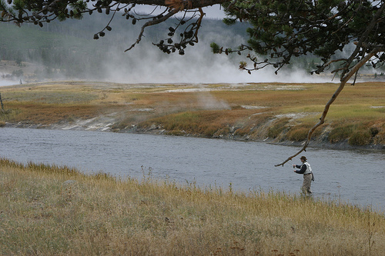
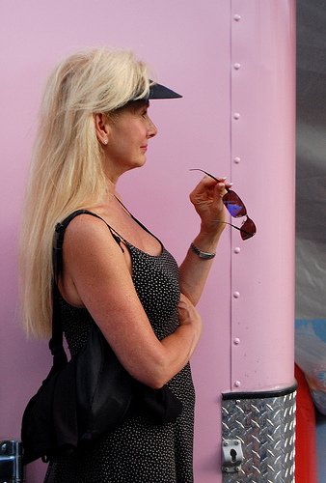

RESULTS
Funny Predictions ??
Actual Caption:
man fly fishing in a small river with steam in the background
Predicted Caption:
Man is swinging on a swing along a stream
Actual Caption:
a woman wearing a black and white outfit while holding her sunglasses
Predicted Caption:
man in pink dress is holding her head
Actual Caption:
a group of different people are walking in all different directions in a city
Predicted Caption:
group of people walking ocean

Slide 12
RESULTS
Predictions that went really wrong!
Actual Caption:
A man wearing a red life jacket is holding a purple rope while waterskiing
Predicted Caption:
man in white and white and white shorts leash on swing
Actual Caption:
A dog is chewing on a metal pole
Predicted Caption:
dog is standing in its mouth
Actual Caption:
a young hockey player playing in the ice rink
Predicted Caption:
chasing player in motorcycle is playing chasing

Slide 13


Future WORK
We can enhance the predictions by using more training examples. For example using Flickr32k dataset which has 32000 images
Implement visual attention techniques, which focuses on interesting parts of the image
Creating an application for visually impaired to convert the generated caption into voice output

Slide 14
THANK YOU

